Slide 1

Trace Tracker
Andhavarapu Balu 22BCE1144
P. Akhil Tej 22BCE1619
Ishan D. Jain 22BCE5073
https://github.com/JustTheCoolest/MappingEnvironment-CollegeProject

Slide 2

Abstract
In an era of rapidly advancing technology, the need for intelligent, self-aware navigation systems is more pressing than ever.
The project at hand proposes the development of a novel system that combines path tracking and location recognition capabilities to enhance the efficiency and precision of navigation.
This system empowers an autonomous model, such as a robot or a drone, to traverse and remember the path it has taken.
As the model navigates, it continually records and analyzes its movements, creating a digital representation of its journey.
When the model revisits a previously encountered location, it leverages this recorded data to recognize the area and make informed decisions based on its prior experiences.

Slide 3
Motivation
In modern days, often valuable time, energy and memory are wasted revisiting locations already covered, incurring operational costs and depleting battery life.
We witness wastage of resources and increased costing with less efficient navigation system, which not only hampers productivity but also contributes to environmental degradation and wastage of time

Slide 4
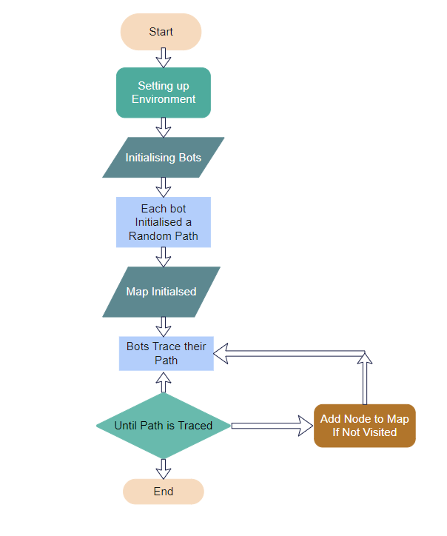
High Level Design

Slide 5
Low level design of the probe
Class: “ Bot “
Create new map
Create
(Instantiation)
Set initial coordinates
2D: x,y
3D: x,y,z
Link to map of another probe
Move instruction
(Function call)
Move physically
Inform the map
Read from sensor
Give data to map

Slide 6
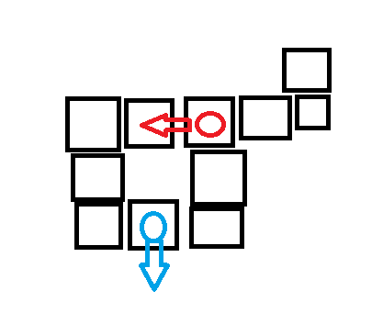

Slide 7
Modules Used
Simulated Environment module
int data[][] - A 2D array representing the data in the environment.
int initial_position[] - The initial position of the bot in the environment.
int position[] - The current position of the bot in the environment.
int width, height - The dimensions of the environment.
int bot_index - An index representing the bot.
SimulatedEnvironment constructors to initailize the environment with a random position,, given dimensions and bot index
Int[] pickRandomPositionForBot() int[] generateRandomPath ( int size )
Void fillData() - fills data in env void showData() - prints data in env
Int[] pickRandomPosition()
IsValidMove(int position[], int direction)
Int [] getIndices (int position[])
Void move(int direction, String terminal_colour)
Void printPosition(String terminal_colour) - Prints the current position of the both in the environment

Slide 8
Map module:
A Binary Search Tree of nodes
Initialised with single node
Void show() - Prints the map with the nodes
Void move (int direction, int[] coordinates) – Moves to a new node in the specified direction from the current node at the given coordinates. If the new node doesn’t exist, it creates one.
Void writeData ( int data, String who_colour, int[] coordinates) – Writes data and color to the node at the given coordinates
Bot module:
SimulatedEnvironment env // represents the environment in which the bot operates
Map map // represents the map the bot navigates
Int coordinates[] // stores the current coordinates of the bot
String terminal_colour // colour left behind by the bot to mark its map
Bot (String terminal_colour, int[] coordinates) - Initializes a Map object, sets the coordinates and colour // and a Copy constructor to copy map reference
void setEnvironment(SimulatedEnvironment env) - Sets the env member and writes data to the map at the current coordinates.
void move(int direction) - Moves the bot in the given direction and writes data to the map at the new coordinates.

Slide 9
BST Module:
TreeNode:
Represents a node in the Binary Search Tree with attributes for data, color, left child, and right child.
BinarySearchTree:
Attributes:
root: The root of the BST.
Methods:
Constructor: Initializes an empty BST.
(Other methods not explicitly listed, such as insertion, deletion, and search operations on the BST.)
Driver:
Contains the main method for testing and running the simulation.
Instantiates objects of the Simulated Environment, Bot, and potentially other modules.
Demonstrates how these modules work together in a simulated environment.

Slide 10
CONSTANTS MODULE
Configuration Constants:
ENV_WIDTH and ENV_HEIGHT:
These constants represent the width and height of the simulated environment. They define the dimensions of the 2D array that represents the environment.
BOT_COUNT:
This constant indicates the number of bots present in the simulated environment. It helps in setting up the initial conditions of the simulation.
Direction Constants:
UP, DOWN, LEFT, RIGHT:
These constants represent the four cardinal directions. They are used in the simulation to specify the movement direction of the bots or any other entities.
Colour Constants:
RED, GREEN, RESET:
These constants define ANSI escape codes for text color in the console. They can be used to format the output by changing the text color to red or green and resetting it back to the default color.

Slide 11
Bot
(multiple copies)
Environment and
hardware
Map
Search tree
Driver
Constants
Activate
Create Map
Connect
Connect same map
Move in world
Inform map
Translate abstract directions
Move instructions
Read
Check if repeat
Create node if not
SAVE DATA
DISPLAY

Slide 12
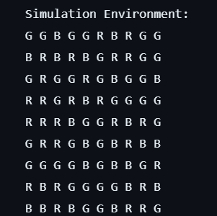
Simulator:
A MxN matrix grid of data that will be read by the probes in an incomplete manner, and correspondingly be stored into the map in an efficient manner

Slide 13
SOURCE CODE
private SearchNode insert(SearchNode root, Node node) {
if (root == null) {
root = new SearchNode(node);
return root;
}
if (node.key() < root.map_node.key()) {
root.left = insert(root.left, node);
} else if (node.key() > root.map_node.key()) {
root.right = insert(root.right, node);
}
return root;
}
public class BST {
SearchNode root;
public int max_x=-1, max_y=-1, min_x=1, min_y=1;
public BST() {
this.root = null;
}
public void insert(Node node) {
root = insert(root, node);
if (node.x > max_x) {
max_x = node.x;
}
if (node.y > max_y) {
max_y = node.y;
}
if (node.x < min_x) {
min_x = node.x;
}
if (node.y < min_y) {
min_y = node.y;
}
}
public Node search(int[] coordinates) {
return search(root, coordinates);
}
private Node search(SearchNode root, int[] coordinates) {
if (root == null) {
return null;
}
if (Node.key(coordinates) == root.map_node.key()) {
return root.map_node;
}
if (Node.key(coordinates) < root.map_node.key()) {
return search(root.left, coordinates);
}
return search(root.right, coordinates);
}
}

Slide 14
Bot code
import java.util.Arrays;
public class Bot {
SimulatedEnvironment env;
public Map map;
private int coordinates[];
String terminal_colour;
private void constructor(){
}
public Bot(String terminal_colour){
this.map = new Map();
coordinates = new int[2];
coordinates[0] = 0;
coordinates[1] = 0;
this.terminal_colour = terminal_colour;
constructor();
}
public Bot(String terminal_colour, int[] coordinates, Map map){
this.map = map;
this.coordinates = Arrays.copyOf(coordinates, coordinates.length);
this.terminal_colour = terminal_colour;
constructor();
}
public Bot(String terminal_colour, Bot bot){
this.map = bot.map;
this.coordinates = Arrays.copyOf(bot.coordinates, bot.coordinates.length);
this.terminal_colour = terminal_colour;
this.env = bot.env;
constructor();
}
public void setEnvironment(SimulatedEnvironment env){
this.env = env;
this.map.writeData(this.env.readData(coordinates), terminal_colour, this.coordinates);
}
public void move(int direction){
this.map.move(direction, this.coordinates);
this.map.writeData(this.env.readData(coordinates), terminal_colour, this.coordinates);
}
}

Slide 15
Color, ConfigurationConstants and direction
//Colour.java
public class Colour {
final static int RED = 0, GREEN = 1, BLUE = 2;
public static int pickRandom() {
return (int) (Math.random() * 3);
}
public static String toString(int color) {
switch (color) {
case 0:
return "R";
case 1:
return "G";
case 2:
return "B";
}
return "N";
}
}
// ConfigurationConstants
public class ConfigurationConstants {
public static final int ENV_WIDTH = 10;
public static final int ENV_HEIGHT = 10;
public static final int PATH_LENGTH = 70;
}
//Direction.java
public class Direction {
public static int UP = 0, DOWN = 1, LEFT = 2, RIGHT = 3, NONE = -1;
public static int inverse(int direction) {
switch (direction) {
case 0: // Move up
return 1;
case 1: // Move down
return 0;
case 2: // Move left
return 3;
case 3: // Move right
return 2;
}
return -1;
}
}

Slide 16
//Map.java
public class Map {
private BST nodes;
public Map() {
nodes = new BST();
nodes.insert(new Node(new int[] {0, 0}));
}
public void show() {
System.out.println("Map:");
int max_x = nodes.max_x;
int max_y = nodes.max_y;
int min_x = nodes.min_x;
int min_y = nodes.min_y;
for (int i = min_y; i <= max_y; ++i) {
for (int j = min_x; j <= max_x; ++j) {
Node current = nodes.search(new int[] {j, i});
if (current == null) {
System.out.print(" ");
} else {
System.out.print(current.who_colour + Colour.toString(current.data) + "\u001B[0m" + " ");
}
}
System.out.println();
}
void move(int direction, int[] coordinates) {
Node current = nodes.search(coordinates);
switch (direction) {
case 0: // Move up
coordinates[1]--;
break;
case 1: // Move down
coordinates[1]++;
break;
case 2: // Move left
coordinates[0]--;
break;
case 3: // Move right
coordinates[0]++;
break;
}
Node next = nodes.search(coordinates);
if (next == null) {
next = new Node(coordinates);
nodes.insert(next);
}
current.adjacent[direction] = next;
next.adjacent[Direction.inverse(direction)] = current;
show();
}
void writeData(int data, String who_colour, int[] coordinates) {
Node current = nodes.search(coordinates);
current.data = data;
current.who_colour = who_colour;
}
}

Slide 17
public class Node {
int x;
int y;
Node adjacent[] = new Node[4];
int data;
String who_colour;
public Node(int coordinates[]) {
this.x = coordinates[0];
this.y = coordinates[1];
// Initialize adjacent array to null values
for (int i = 0; i < adjacent.length; i++) {
adjacent[i] = null;
}
}
int key() {
/* Task: Any alg that works on infinite data size
key = max(len(x), len(y)) as num string len
*/
return Node.key(new int[]{x, y});
}
static int key(int coordinates[]){
return coordinates[0] * 1000 + coordinates[1];
}
}
public class SearchNode {
Node map_node;
SearchNode left;
SearchNode right;
public SearchNode(Node map_node) {
this.map_node = map_node;
this.left = null;
this.right = null;
}
}

Slide 18
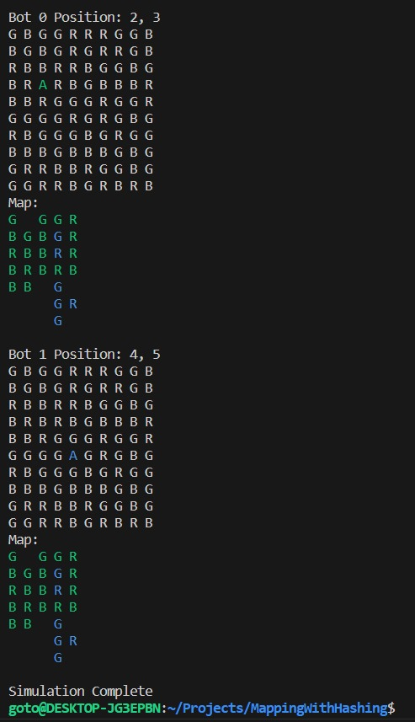
Output

Slide 19
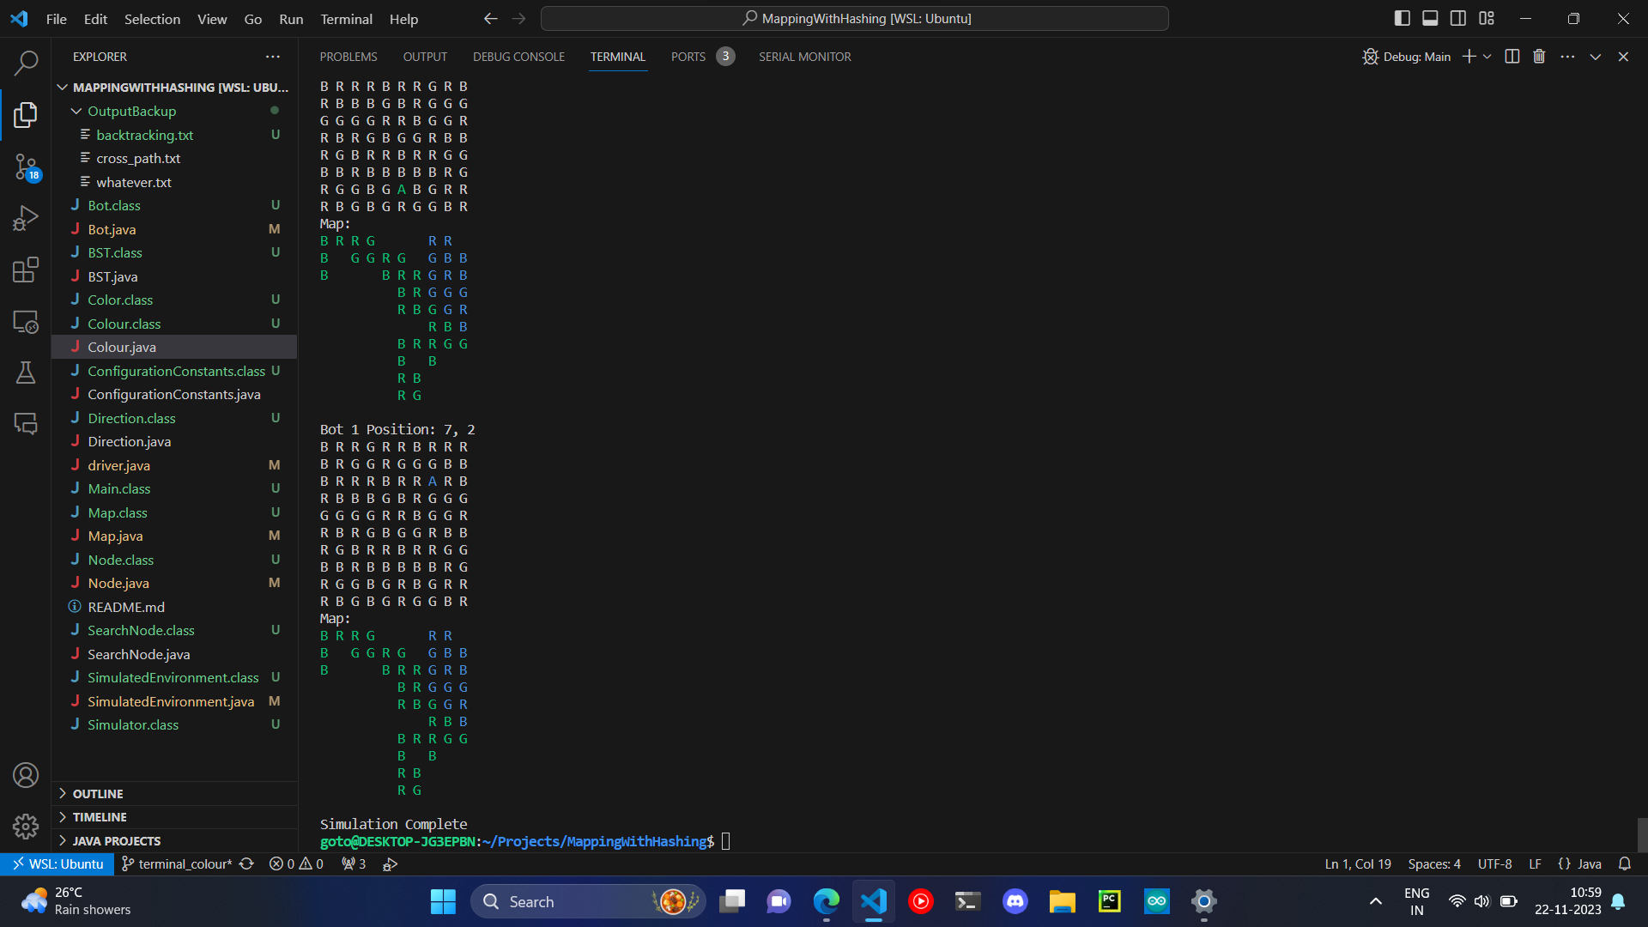

Slide 20

Significance
Efficient Resource Utilization
2. Cost Reduction
3. Sustainability
4. Memory Efficient
Applications 1. Agricultural automation
2. Tracing the ocean beds
3. Delivery services

Slide 21
The core premise of our project is simple yet profound:
A model that remembers its journey and intelligently adapts its path when revisiting known locations.
This system has the potential to revolutionize the way autonomous models operate, offering a unique blend of efficiency, resource optimization, and adaptability.
Conclusion

